Slide 1



Module #4 – Software Black-Box Testing Methods
Software Testing
Topic #5 – Scenario Testing Method
Instructor: Jerry Gao, Ph.D., Professor
San Jose State University
Notes:
From this session, we start to Module #2 on Software Testing Fundamentals.
In this module, we cover the basics of software testing, including the following subjects:
Topic #1 - Software Problem Management
Topic #2 - Software Test Design
Topic #3 - Software Test Management

Slide 2
Topic #4 – Scenario Testing METHOD
Software Testing
What is Scenario Testing?
Why Is Scenario Testing Important?
How to Perform Scenario Testing?
Scenario Testing Examples
Scenario Testing Summary
Notes:
This is the first package in Module 3 for Software Testing Class. It provides an introduction to software white-box testing. It covers the following
What is white-box testing?
Why Is white-box testing important?
Who does white-box testing?
White-box testing focuses
White-box testing coverage

Slide 3
Topic #4 – Scenario Testing METHOD
Software Testing
What is scenario-based testing?
Scenario testing is done by creating test scenarios which replicate the end users usage scenarios based on the given system requirements and use cases.
A test scenario can be a independent test case or a series of test cases that makes a test suit. Test scenario is just a story which explains the usage of the software by any end user.
In scenario testing, testers needs to communicate with system users, clients, stakeholders, and developers to come up the user scenarios first, then create test scenarios.
In scenario testing the testers put themselves in the end users shoes and figure out the real world scenarios or consider the use cases which can be performed on the software by end users.

Slide 4
Topic #4 – Scenario Testing METHOD
Software Testing
Importance of Scenario Testing
Since scenario testing focus on system usage scenarios, it helps engineers to detect many system usage problems/bugs.
Scenario testing is very useful to check user-oriented system transactions, for example, online banking transactions.
Because scenario testing requires engineers focus on system usage contexts, it is also very effective to discover system context problems on a customer site.
Scenario testing could be useful to end-to-end system functions and user-oriented constraints and workflow operations.

Slide 5
Topic #4 – Scenario Testing METHOD
Software Testing
How to Perform Scenario Testing?
Scenario Testing Steps:
Step #1 – Identify use cases/user operation scenarios
Step #2 - Define test cases based on the identified scenarios
Step #3 - Execute scenario tests
Identify system usage scenarios based on system use cases and user operations by using the following ways:
Story lines
State transitions
Business verticals
Implementation story from customers
You can apply the following approach:
Use-case and role-based scenarios : This method focuses on how a user uses the system with different roles and environment.

Slide 6
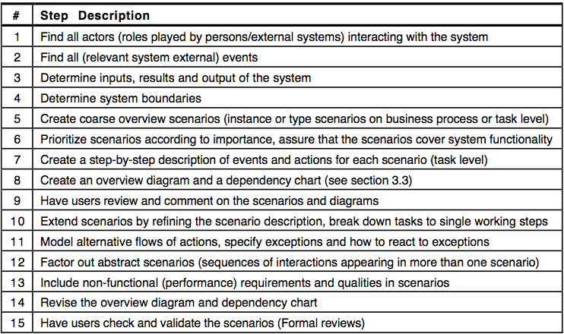
Topic #4 – Scenario Testing METHOD
Software Testing
Scenario Creation Procedure
Below template can be used to formulate the scenario

Slide 7
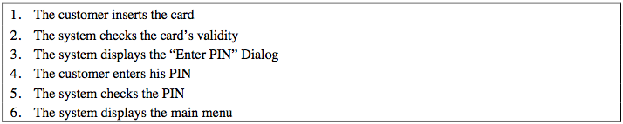
Topic #4 – Scenario Testing METHOD
Software Testing
Scenario Testing Example
Example 1: Authentication Scenario in ATM
The Authentication scenario reads
Precondition: The ATM is operational, card being inserted.

Slide 8
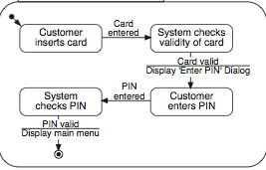
Topic #4 – Scenario Testing METHOD
Software Testing
Scenario Testing Example
The authentication scenario depicted in flow chart.
Notes:
White-box software testing focuses on the following areas:
– Program control/execution paths → to make sure that executable program control flows
can be correctly executed.
Program data → to make sure that program data parameters and values are properly set-up and
accessed.
-

Slide 9
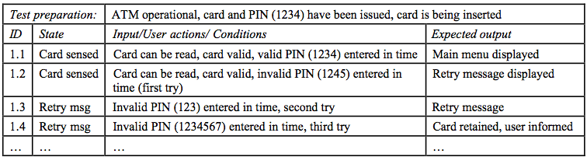
Topic #4 – Scenario Testing METHOD
Software Testing
Scenario Testing Example
Test case derived from the scenario:
Notes:
White-box software testing focuses on the following areas:
– Program control/execution paths → to make sure that executable program control flows
can be correctly executed.
Program data → to make sure that program data parameters and values are properly set-up and
accessed.
-

Slide 10
Topic #4 – Scenario Testing METHOD
Software Testing
Scenario Testing Summary
Advantage:
Helps to find bugs at the application level from user perspectives
Easy to understand and apply based on user-centered understanding
Reduces the chances of repeatability
Understand the complexity of the application easily
Test Coverage:
Scenario-based test coverage based on usage scenarios
Limitations:
Scenario testing only useful for system level testing
Depending on engineers’ understanding of the under-test system
Challenges:
How to achieve the completed coverage for all of system scenarios?
Notes:
White-box software testing focuses on the following areas:
– Program control/execution paths → to make sure that executable program control flows
can be correctly executed.
Program data → to make sure that program data parameters and values are properly set-up and
accessed.
-

